Slide 1

DOCKER 101
Serdar mumcu (Comodo threat RESEARCH labs SOFTWARE ARCHITECT)
Serdar.mumcu@comodo.com
https://github.com/serdarmumcu/nurddockertraining

Slide 2
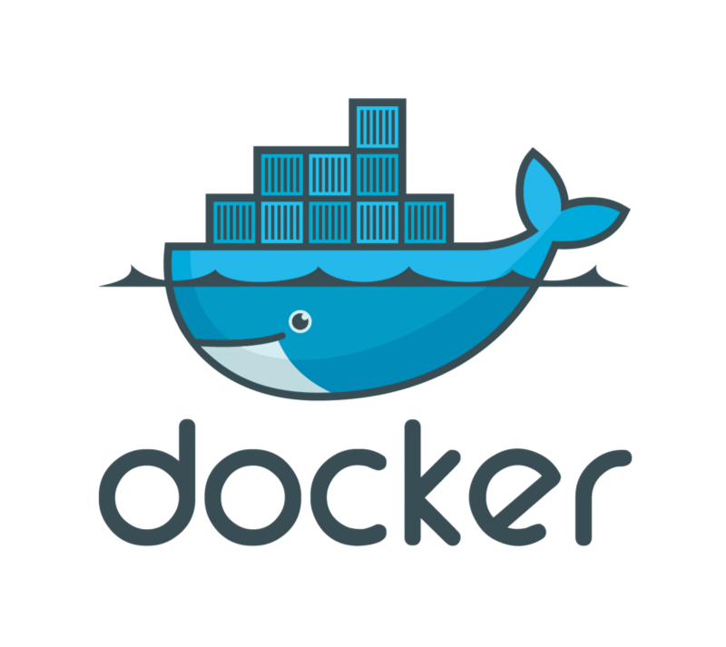
Outlıne
What is Container?
What is Docker?
Docker Terminology
Docker Installation
Docker CLI Usage
Docker Persistence
Docker Networking
Custom Docker Images

Slide 3
outlıne
Docker-Compose
Workshop
Elasticsearch, Redis Cluster
Node.js
Deployment to Digital Ocean
Using DockerCloud
DockerCloud & DockerHub for CI
Amazon Elastic Container Registry

Slide 4
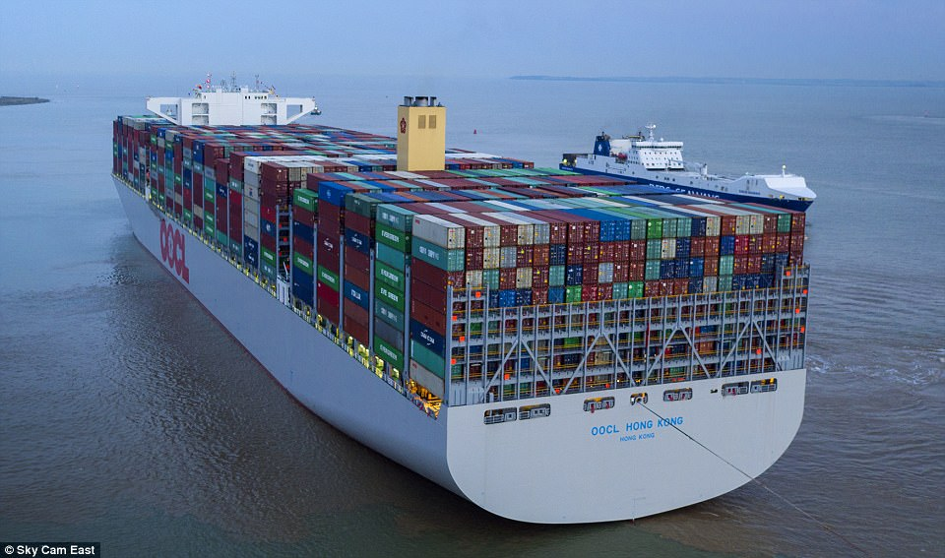
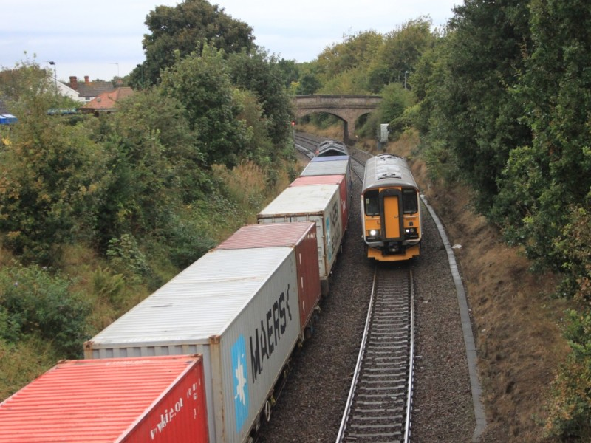
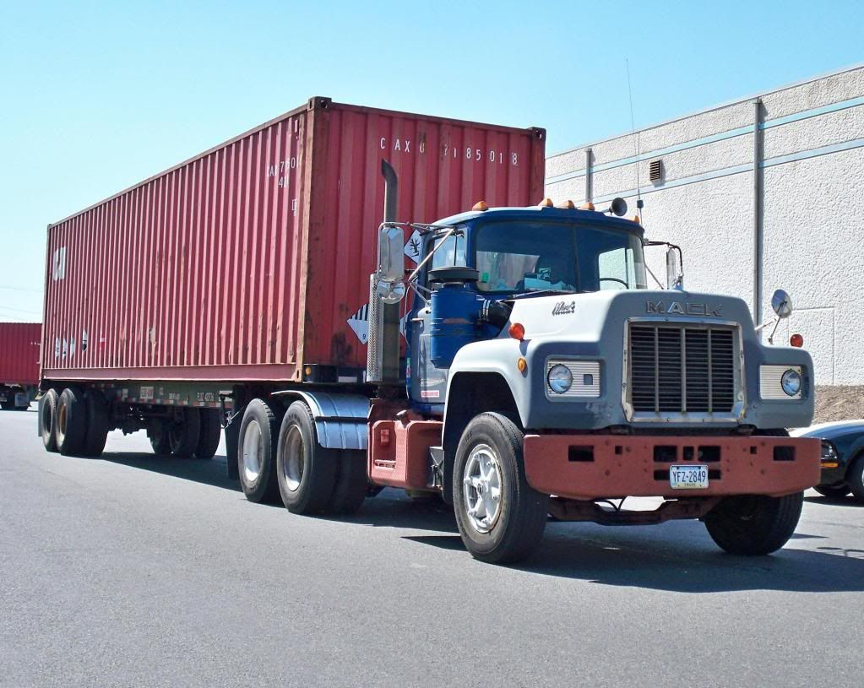
what ıs Container?

Slide 5
what ıs docker?
Solomon Hykes
Since 2013
Docker Inc.
Written in Go

Slide 6
WHY DOCKER?
Solomon Hykes
Since 2013
Docker Inc.
Written in Go

Slide 7
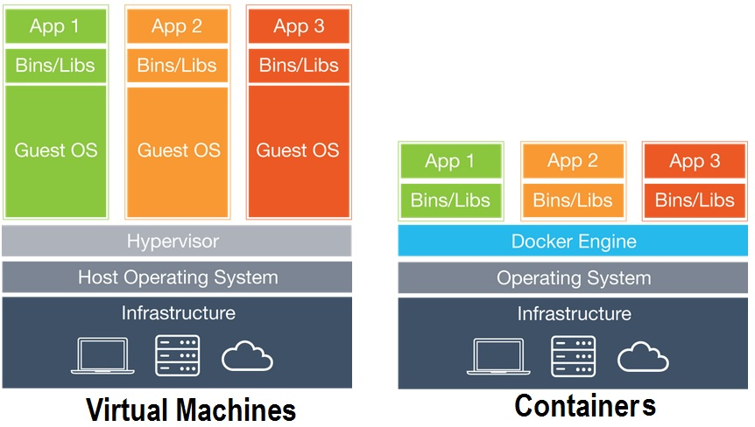
Vm vs. contaıners

Slide 8
DOCKER TERMINOLOGY
Docker Image
Docker Container
Docker Volume
Docker Registry
Docker CLI
Docker Daemon (Engine)

Slide 9
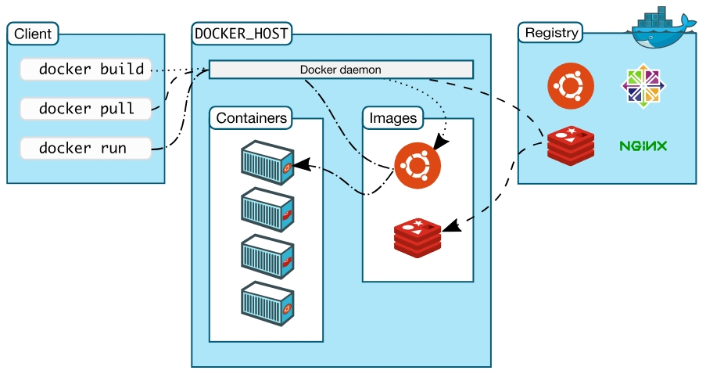
Docker archıtecture

Slide 10
Docker ınstallatıon
https://store.docker.com/
Mac , Windows, Centos, Debian, Fedora, Ubuntu
IaaS (AWS, Azure)
DockerCloud (1 free private repo)
Visual Studio Code (Recommended)

Slide 11
Docker CLI
docker version / docker info
docker / docker --help
docker container run --rm
docker image ls
docker volume ls
docker ps

Slide 12
Docker CLI
docker container run -p 8080:80 nginx:v1.14
--name
--detach
https://hub.docker.com/explore/
docker stop
docker start
docker logs

Slide 13
Docker CLI
docker container just a process in the host OS
docker run --name mongo –d mongo
ps aux
docker run -it --rm --privileged --pid=host docker4w/nsenter-dockerd

Slide 14
Docker CLI
https://docs.docker.com/
--help
nginx (80:80), postgresql (5432:5432), httpd (8080:80)
use –d and –name
use -e or --env to pass POSTGRES_PASSWORD=my-secret-pw

Slide 15
Docker CLI
docker container top
docker container inspect
docker container stats
docker inspect web –format ‘{{ .NetworkSettings.IPAddress }}’
docker run --rm tutum/curl curl <ip-address>
docker stop $(docker ps -aq)

Slide 16
Docker CLI
Getting a shell inside containers
docker container run –it
docker container exec –it
docker container run –it –name proxy –p 8080:80 nginx bash
When you exit, container will stop since we changed the default command
docker container start –ai ubuntu
docker container run -it alpine sh

Slide 17
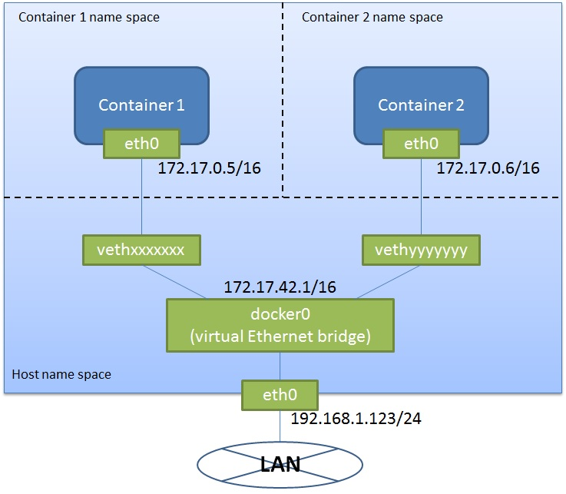
Docker NETWORKING

Slide 18
Docker NETWORKING
docker container run –p
docker container port <container>
docker network ls
Bridge, Host, None
docker network inspect bridge
docker network create mynetwork (--driver)

Slide 19
Docker NETWORKING
docker container run -d --name proxy –network mynetwork nginx
docker network inspect mynetwork
docker network connect
docker network disconnect
DNS (we cannot rely on the IP Addresses)
docker container run –d --name newproxy --network mynetwork nginx
docker container exec -it newproxy ping proxy
--link (for default bridge network) - in docker-compose it is easier

Slide 20
Docker NETWORKING
docker network create test
docker container run –d --net testnetwork --net-alias mysearch elasticsearch:2
docker container run –d --net testnetwork --net-alias mysearch elasticsearch:2
docker container run --rm --net testnetwork alpine nslookup mysearch
docker container run --rm --net testnetwork centos centos curl –s mysearch:9200

Slide 21
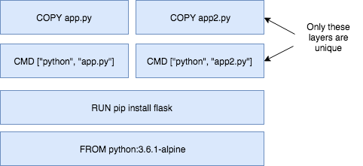
DOCKERFILE: CREATING CUSTOM DOCKER IMAGES
Image: App binaries and dependencies (No kernel, no kernel modules)
Image layers
docker history nginx:latest

Slide 22
DOCKERFILE: CREATING CUSTOM DOCKER IMAGES
Dockerfile
FROM
ENV
RUN
COPY
EXPOSE
CMD

Slide 23
Docker PERSISTENCE

Slide 24
DOCKER COMPOSE

Slide 25
WORKSHOP 1
Creatıng elastıcsearch and redıs clusters locally wıth docker compose

Slide 26
WORKSHOP 2
Creatıng a node.js applıcatıon

Slide 27
WORKSHOP 3
Deployment to dıgıtalocean

Slide 28
WORKSHOP 4
Usıng dockercloud for deployment

Slide 29
WORKSHOP 5
Usıng dockercloud and dockerhub for contınuous ıntegratıon

Slide 30
AMAZON ELASTIC CONTAINER REGISTRY

Slide 31
The end
Any questıons or comments?

